Slide 1
ETAS EHANDBOOK 10.1
New approach for generating EHB Containers from .arxml files only

Slide 2






EHB-CB: New approach for generating EHB Containers from .arxml files only
ETAS EHANDBOOK
Scope:
SWCs + Ports + Interface Elements + Connections
Input data for
Dir-based EHB-CB
ECU_Project
EHB-NAV
SWC1
Generate
EHB
Container
SWC1.adoc
SWC2
Dir-based
EHB
Container-Build
SWC2.adoc
SWC3
SWC3.adoc
SWC1.arxml
SWC2.arxml
SWC3.arxml
Composition.arxml

Slide 3

EHB-CB: New approach for generating EHB Containers from .arxml files only
ETAS EHANDBOOK
Demo
EHB-CB
Step 1: Prepare
Step 2: Generate
Scope:
SWCs + Ports + Interface Elements + Connections
Directory with
.arxml files for ASW
(SWCs + a Composition)
Input data for
Dir-based EHB-CB
ECU_Project
EHB-NAV
Create
SWC1
Generate
EHB
Container
SWC1.arxml
SWC2.arxml
SWC3.arxml
Composition.arxml
SWC1.adoc
Dir-based
EHB
Container-Build
CLI option:
-ar2ehbcbinput
SWC2
Dir-based
EHB
Container-Build
SWC2.adoc
SWC3
SWC3.adoc
SWC1.arxml
SWC2.arxml
SWC3.arxml
Composition.arxml
Benefits:
Only .arxml files for ASW required (e.g., ISOLAR-A project) to get started with EHB
Reduced entry hurdle as input data for EHB-CB is automatically generated
Learn how EHB-CB works
2 step approach such that auto-generated input data can be altered (e.g., additional ASCET / SL models or C-Code)

Slide 4


EHB-NAV: Features related to AUTOSAR (Classic) support
ETAS EHANDBOOK
Demo
EHB-NAV
Calibration
.a2l
.a2l
INCA
.hex
Scope: Complete Tier-1 ASW
INCA COM API
EHB
Container
EHB-NAV
MDA 8
.dat
.mf4
Tool Binding

Slide 5
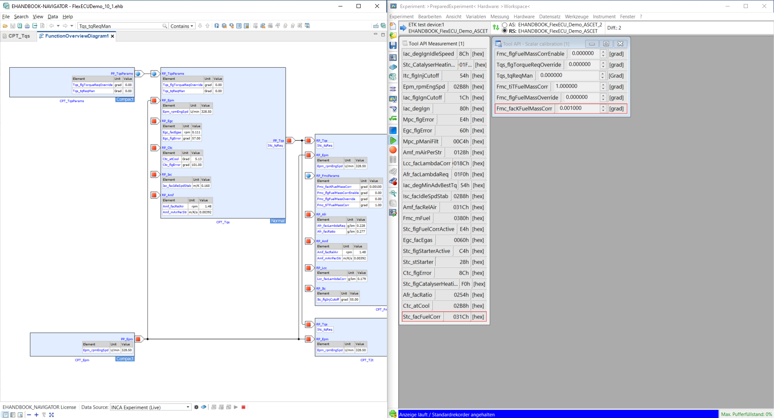
EHB-NAV: Features related to AUTOSAR (Classic) support
ETAS EHANDBOOK
Demo
EHB-NAV
Benefits:
Quickly find information about SWCs (e.g., ports, interface elements) and A2L labels
Understand dependencies between SWCs though overview diagrams
Create INCA experiments with few clicks
„See“ live running values from INCA in AUTOSAR architecture visualization
Utilize EHB + MDA 8 finding calibration issues

Slide 6
Thank you

